Slide 1


Data PREPROCESSING in python USING pandas
Dennis van den Berg

Slide 2


planning
Short intro on preprocessing
Useful transformation techniques
Tools: pandas
Info sources
Demo notebook
Learning by doing
Weather Data Exercises
Additional Exercises

Slide 3
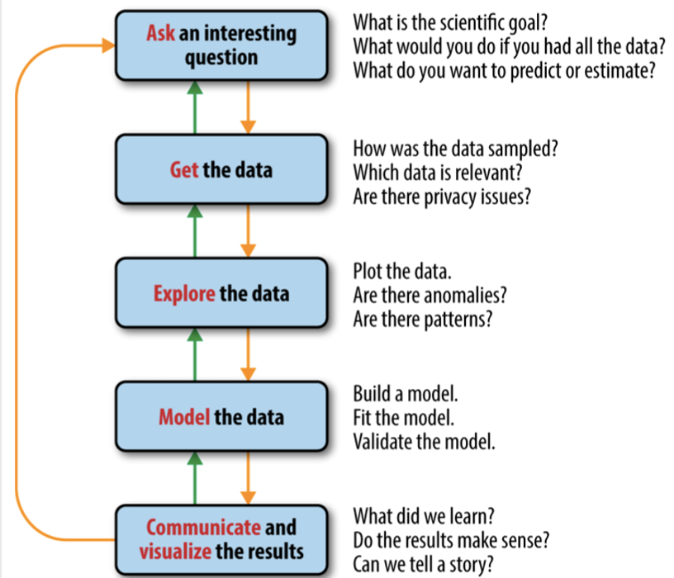
The data science process

Slide 4
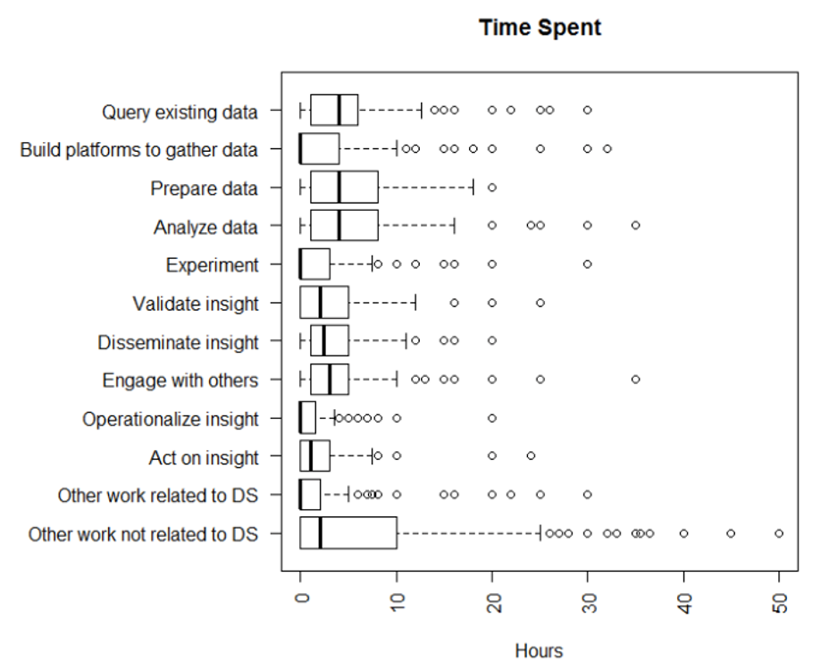
Not every data scientist does the same

Slide 5
Useful techniques

Slide 6
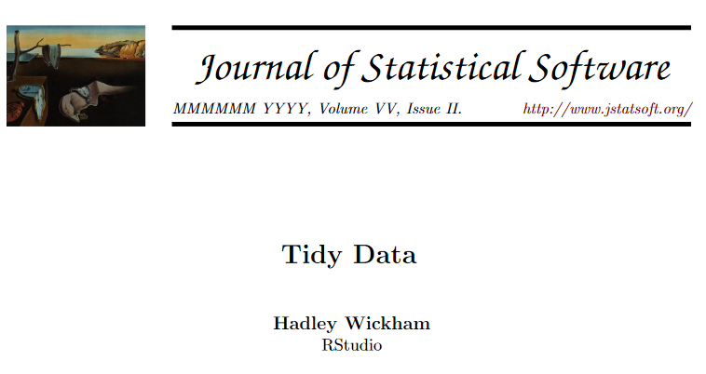
Concept of Tidy data
Criteria of tidy data:
Each variable forms a column
Each observation forms a row
Each type of observational unit forms a table
See also: http://vita.had.co.nz/papers/tidy-data.pdf
Paper by Hadley Wickham that goes into long wide format (mostly theory and little bit of R)

Slide 7
Most common problems With messy datasets
Column headers are values, not variable names
Multiple variables are stored in one column
Variables are stored in both rows and columns
Multiple types of observational units are stored in the same table
A single observational unit is stored in multiple tables
Missing values

Slide 8
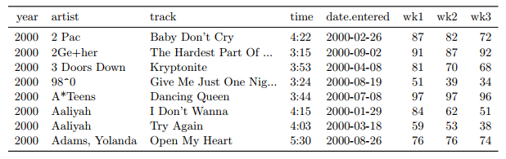
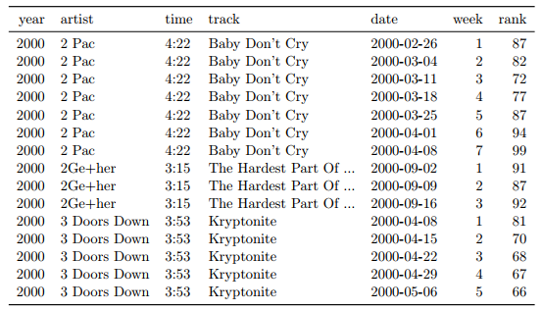
Example 1: Long/wide format
In which format is the table? Long or wide?
What does the 87 mean in the first row?
What about the 82?
Besides switching from wide to long, also some tidying and cleaning has been done
Simply going to wide would create a column with strings wk1, wk2, wk3 so the number has been extracted
Date is calculated from date.entered and the week number

Slide 9
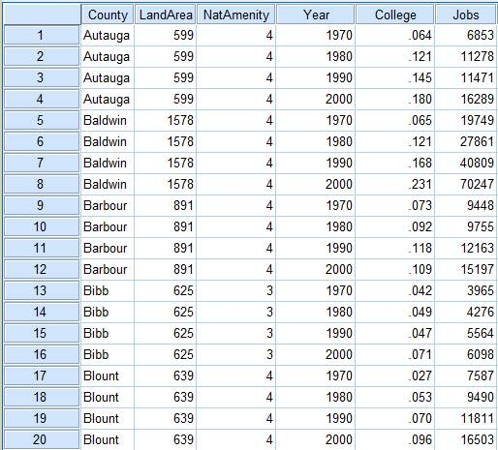
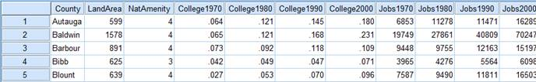
Example 1: Long/wide format
What are potential reasons for choosing long or wide format?
Suppose we apply regression to both dataframes, which regression captures the effect of time?
Python (pandas):
pivot (long to wide)
melt (wide to long)
R (tidyr):
Spread (long to wide)
Gather (wide to long)

Slide 10
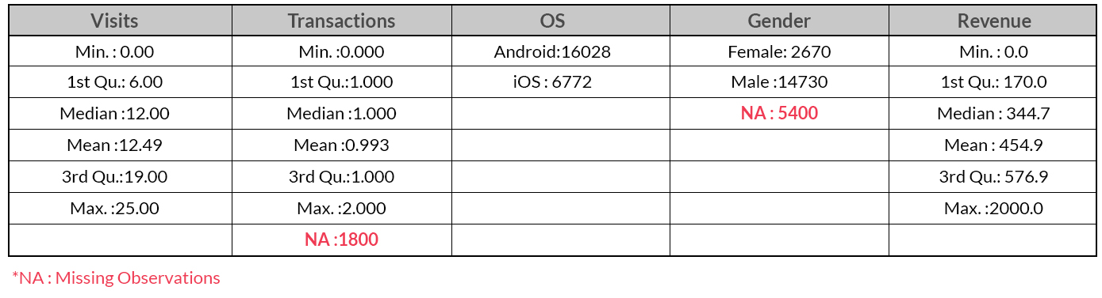
Example 2: Missing value imputation
Suppose we want to predict revenue
What to do with missing values?
Remove
Impute
Impute with what?
Grouped mean/median/mode
‘New’ value
Estimate -> apply ML model (for example random forest)
Choices often require domain knowledge!

Slide 11
Toolkit: pandas

Slide 12
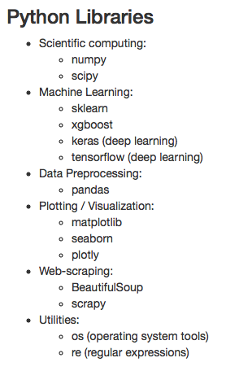
pandas
Importing data
Preprocessing
Some visualization

Slide 13
background
Originally created by Wes McKinney in 2008, also the author of 'Python for Data Analysis' (see references)
Has become one of the most used Python libraries for data manipulation and analysis
Built on top of NumPy (low level math library)
Written in Python, Cython and C

Slide 14
FUNCTIONALITY
Provides:
Rich time series functionality
Data slicing, subsetting, sampling
Reshaping
Groupby operations
Merge and join methods
Many other conveniences
Supports data structures:
DataFrames: array-like structure, which consists of columns that are pandas Series
Series: one-dimensional labeled array capable of holding any data type (integers, strings, floating point numbers, Python objects, ..)

Slide 15
Advantages & LIMITATIONS
Advantages:
Easy to use
Lot of functionality
No need to loop over rows when manipulating data
Clear representation of data in Jupyter Notebooks
Limitations:
Scalability (although projects like Dask aim to scale pandas)

Slide 16
Additional
Info sources

Slide 17
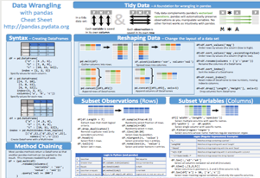
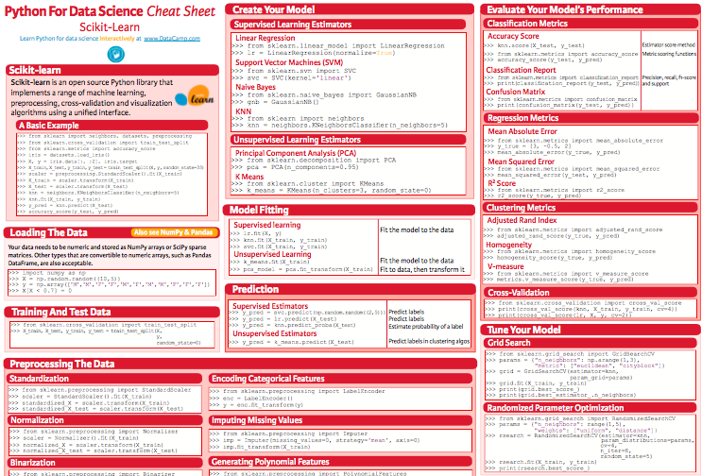
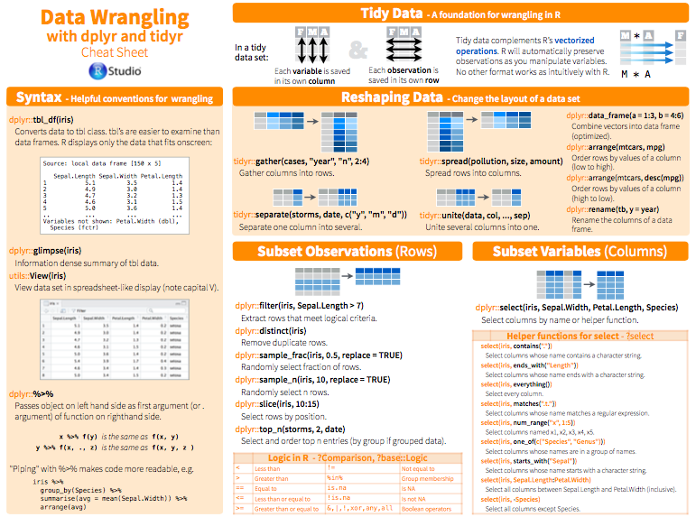
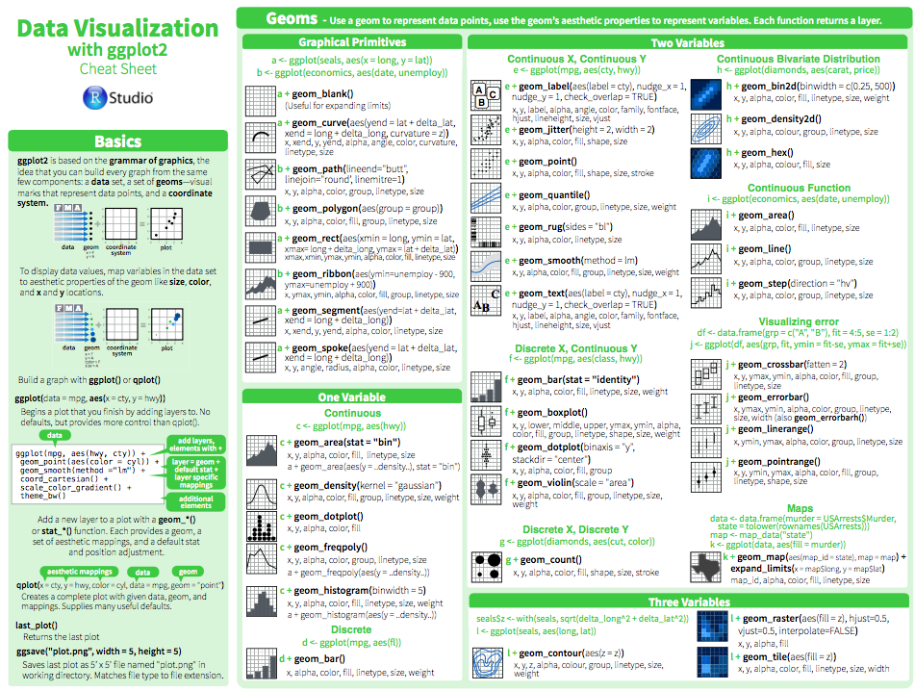
Most common problems With messy datasets
Cheat sheets
See handouts
Also contained in course materials

Slide 18
references
Pandas documentation:
http://pandas.pydata.org/pandas-docs/stable/
Python for Data Analysis (Wes McKinney):
https://www.amazon.com/Python-Data-Analysis-Wrangling-IPython/dp/1449319793
Pandas in 10 minutes:
http://pandas.pydata.org/pandas-docs/stable/10min.html
Things in Pandas I wish I'd known earlier:
http://nbviewer.jupyter.org/github/rasbt/python_reference/blob/master/tutorials/things_in_pandas.ipynb

Slide 19
Example notebooks
Demo notebook of this lesson
We will have a look at this right after this presentation
Titanic Data Set notebooks (Kaggle):
https://www.kaggle.com/npat0003/titanic-data-wrangling-and-analysis
https://github.com/TarekDib03/titanic-EDA/blob/master/Titanic%20-%20Project.ipynb

Slide 20

THANK YOU FOR YOUR ATTENTION
Pedro de Medinalaan 11, 1086 XK Amsterdam
020 - 773 1972
www.anchormen.nl

Slide 21
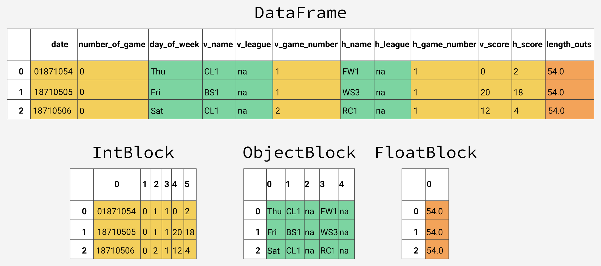
Pandas memory management
Under the hood pandas stores a DataFrame in blocks of data of the same type
Memory usage can often be reduced by:
Downcasting numeric columns to more efficient types
Converting string columns to the categorical type.
More info: https://www.dataquest.io/blog/pandas-big-data/

